Slide 1
Unit-5 Motivation and Emotion

Slide 2
Outline Of The Unit:
Part I: Motivation
1. Definition of Motivation
2. Classifications of Motivation
3. Major Theories of Motivation
Part II: Emotion
1. Meaning of Emotion
2. Theories of Emotion

Slide 3
1.What Is Motivation?
Motivation: is the force within the individual that accounts for the level, direction, and persistence of effort expended at work.
- Direction: an individual’s choice when presented with a number of possible alternatives.
- Level: the amount of effort a person puts for
- Persistence: the length of time a person stays with a given action.

Slide 4
What is Motivation?
Motivation: Psychological processes that cause the arousal, direction, and persistence of voluntary actions that are goal directed.
Motivation Behavior

Slide 5
Note
Behavior is purposive rather than random i.e. People exhibit both positive (work done on time) and negative (arrive late for work) behavior for a reason.
Motivation arouses people to do something i.e. People are unlikely to change a behavior or do something different unless they are motivated to do so.

Slide 6
Conti…
Motivation causes people to focus on a desired end-result or goal.
Motivation fuels the persistence needed to exhibit sustained effort on a task.
In general, the word motivation refers to getting someone moving. When we motivate ourselves or someone else, we develop incentives or we set up conditions that start or stop behavior.

Slide 7
2. Classification of Motivation
Motivation can be classified into two broad categories:-
A. Intrinsic Vs. Extrinsic Motivation
B. Primary Vs. Secondary Motivation

Slide 8
A. Intrinsic Vs. Extrinsic Motivation
A.1.Intrinsic(internally-oriented) Motivation:
is a motivation to engage in an activity for its own sake.
Example:- Intrinsically motivated learners study hard because studying is viewed as enjoying or worthwhile by itself.

Slide 9
A.2. Extrinsic (Externally-Oriented)
refers to a motivation to engage in an activity as a means to achieve an end. It is based on external rewards, obligations or similar factors, not on the inherent satisfaction of a task or activity.
Example:- Extrinsically motivated learners may study hard for a test because they believe studying will lead to a high test score, teacher compliments, a good grade in the class…

Slide 10
B. Primary Vs. Secondary Motivation
B.1. Primary Motives:-
Are those that are part of the biological make up of the organism.
They are based on physiological needs. Primary needs are homeostasis- which is the tendency of the body to maintain itself in a stable condition with regard to the physiological process.
Examples: hunger, thirst, sleep…

Slide 11
B.2. Secondary Motives
refers to a motivation that is not naturally given, but that arises only through the organism's interaction with the environment.
Secondary motives are also known as acquired motives (since they are acquired through individual experience) or social motives (because they all learned in the social environment and usually involve other people).
They are not homeostasis.

Slide 12
Conti…
Examples of secondary Motivation: Addictions, anxiety, generosity, achievement, and all social motives for doing things.

Slide 13
Approaches to motivation (theories of
motivation)
Instinct approaches to motivation
This theory focuses on the biologically determined and innate patterns of both humans and animals behavior is called instincts.
Just as animals are governed by their instincts to do things such as migrating, nest building, mating and protecting their territory, early researchers proposed that human beings may also be governed by similar instincts.

Slide 14
Cont.
According to this instinct theory, in humans, the instinct to reproduce is responsible for sexual behavior, and the instinct for territorial protection may be related to aggressive behavior.
The early theorists and psychologists listed thousands of instincts in humans including curiosity, flight (running away), pugnacity (aggressiveness), and acquisition (gathering possessions).

Slide 15
b) Drive-reduction approaches to
motivation
This approach involved the concepts of
needs and drives.
A need is a requirement of some material (such as food or water) that is essential for the survival of the organism.
When an organism has a need, it leads to a psychological tension as well as physical arousal to fulfill the need and reduce the tension. This tension is called drive.

Slide 16
Cont.
In this theory, there are two kinds of drives; primary and secondary.
Primary drives are those that involve survival needs of the body such as hunger and thirst, whereas acquired (secondary) drives are those that are learned through experience or conditioning, such as the need for money, social approval.

Slide 17
Cont.
This theory also includes the concept of homeostasis, or the tendency of the body to maintain a steady-state.
When there is a primary drive need, the body is in a state of imbalance.
This stimulates behavior that brings the body back into balance or homeostasis.

Slide 18
c) Arousal approaches: beyond drive reduction
According to arousal approaches to motivation, each person tries to maintain a certain level of stimulation and activity.
As with the drive-reduction model, this approach suggests that if our stimulation and activity levels become too high, we try to reduce them.
But, in contrast to the drive-reduction perspective, the arousal approach also suggests that if levels of stimulation and activity are too low, we will try to increase them by seeking stimulation.

Slide 19
d) Incentive approaches: motivation’s pull
Incentive approaches to motivation suggest that motivation stems from the desire to attain external rewards, known as incentives.
Many psychologists believe that the internal drives proposed by drive-reduction theory work in a cycle with the external incentives of incentive theory to ―push‖ and ―pull‖ behavior, respectively.
Hence, at the same time that we seek to satisfy our underlying hunger needs (the push of drive-reduction theory), we are drawn to food that appears very appetizing (the pull of incentive theory).

Slide 20
e) Cognitive Approaches: the thoughts
behind motivation
Cognitive approaches to motivation suggest that motivation is a result of people‘s thoughts, beliefs, expectations, and goals.
For instance, the degree to which people are motivated to study for a test is based on their expectation of how well studying will pay off in terms of a good grade.

Slide 21
f) Humanistic approaches to motivation
The other approach to the study of motivation is the humanistic approach which is based on the work of Abraham Maslow.
Maslow suggested that human behavior is influenced by a hierarchy, or ranking, of five classes of needs, or motives. He said that needs at the lowest level of the hierarchy must be at least partially satisfied before people can be motivated by the ones at higher levels.

Slide 22
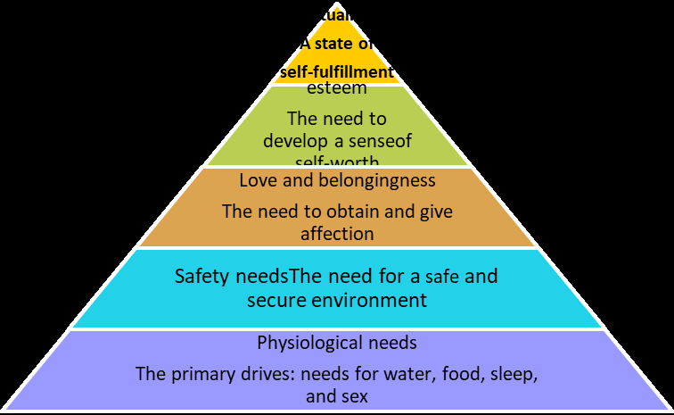

Slide 23
Cont…
There are two hierarchy of needs theory
Deficit principle
A satisfied need is not a motivator of behavior.
Progression principle
A need at one level does not become activated until the next lower-level need is satisfied.

Slide 24
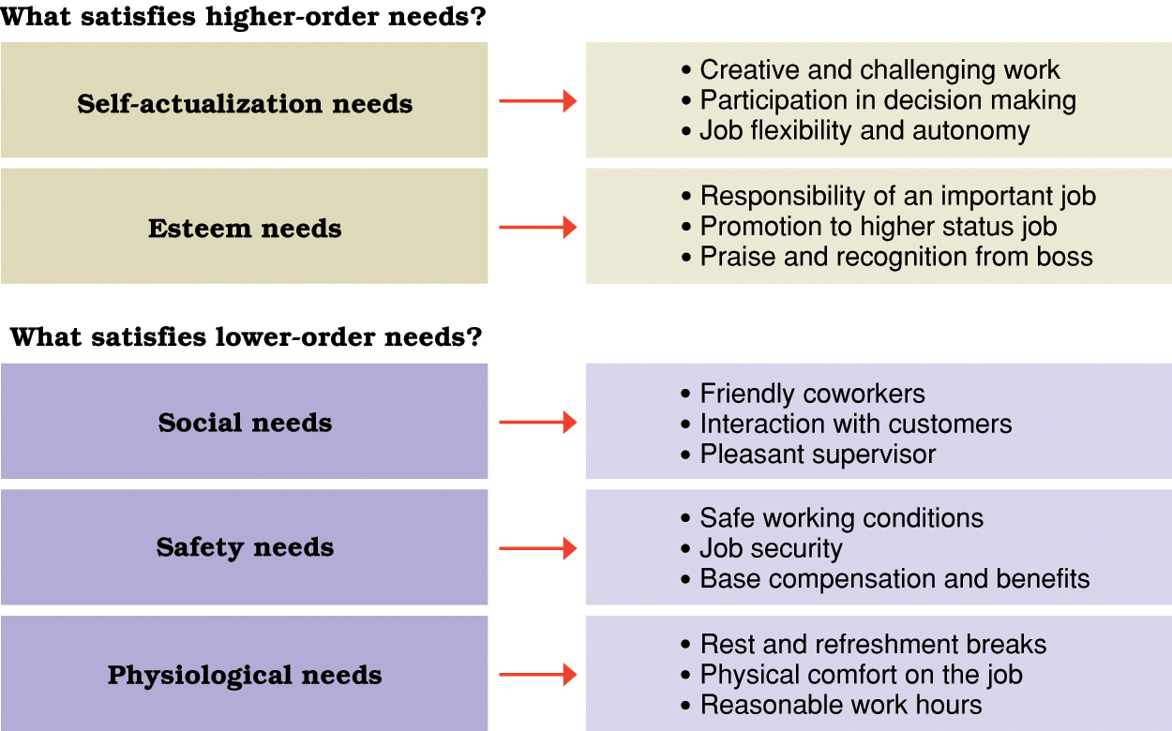
Conti… Opportunities for satisfaction in Maslow’s hierarchy of human needs.

Slide 25
Frustration and Conflict of Motives
Frustration refers to to the blocking of any goal directed behaviour.
If motives are frustrated, or blocked, emotional feelings and behaviour often result. People who cannot achieve their important goals feel depressed, fearful, anxious, guilty, or angry.
Sources of Frustration
Environmental forces: Environmental factors can frustrate the satisfaction of motives by making it difficult or impossible for a person to attain a goal. Example lack of money, teacher, parent, police, etc.

Slide 26
Cont.…
Personal inadequacies: Setting unattainable goals can be important sources of frustration. People are often frustrated because they aspire to goals beyond their capacity to perform.
Conflict of motives: Conflict exists whenever a person has incompatible or opposing goals.
The frustration comes from being unable to satisfy all the goals.
Whatever goal the person decides to satisfy, there will be frustration, most likely preceded by turmoil (confuse disturbance), doubt, and vacillation (unable to decide).
Example: Aggression and social approval are in
conflict (Why?)

Slide 27
Motivational Conflict
Of the three general sources of frustration described above the one that often produces the most persistent and deep-seated frustration in many individuals is motivational conflict/ conflict of motives.
There are about four basic kinds of motivational conflicts. 1. Approach- Approach Conflict
Occurs when one is simultaneously/ equally attracted to two or more desirable goals/ outcomes.
Generally, such conflicts cause little distress and are easily resolved.
The reason is that although we must choose one alternative now, we can often obtain the other at a later time or give up it.
E.g. attracted to two depts., attracted to huger and sleep

Slide 28
2. Avoidance- Avoidance Conflict
This conflict occurs when we are motivated to avoid each of two (or more) equally unattractive choices, but must choose one.
Avoidance- avoidance conflicts tend to involve a great deal of vacillation and hesitation.
Moving closer to one of the unattractive choices increases our discomfort and leads us to retreat.
This retreat brings us closer to the other unattractive alternative, and we retreat in the opposite direction.
Example: Studying hard or Failure, Working job we dislike or losing income.
Such conflicts are capsuled in the saying, “caught between the devil and the deep blue sea.”

Slide 29
3. Approach-avoidance conflict
This kind of conflict occurs when a person is motivated to both approach and avoid the same goal object.
In these kinds of conflicts both attraction and repulsion are typically strongest when you are nearest the goal.
The closer you are to something appealing, the stronger your desire to approach it; but the closer you are, the negative valence becomes stronger and you desire to flee.
In such cases people reach the goal but much more slowly and hesitantly than they would have without the negative valence.
Until the goal is reached there is frustration.

Slide 30
Cont.…
Even after the goal is reached, an individual may feel uneasy because of the negative valence attached to it.
Whenever a person is frustrated by not reaching it at all, emotional reactions such as fear, anger, and resentment commonly accompany approach avoidance conflicts. E.g. Getting married or losing her job or marriage in itself.
4. Multiple approach-avoidance conflicts
Such conflicts are the ones we most often face in life.
These involve situations in which several options exist, with each one containing both positive and negative elements.
Not surprisingly these are the hardest to resolve and the most stressful. E.g. Living in countryside or in city

Slide 31

Emotion
Notes:
We’ll talk about
- how emotions expressed and identified
- some theories of how emotions work
- how the nervous system is involved in the process of producing emotions
- and something about what is happening in the example of aggression and violence

Slide 32
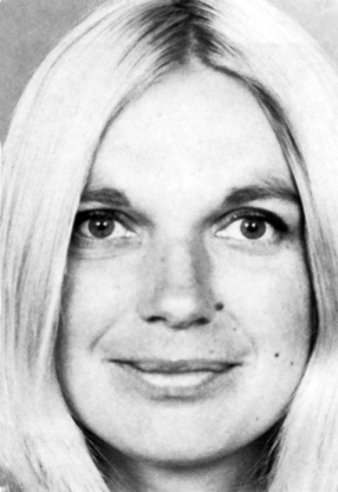
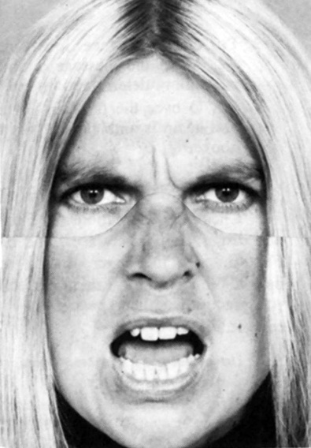
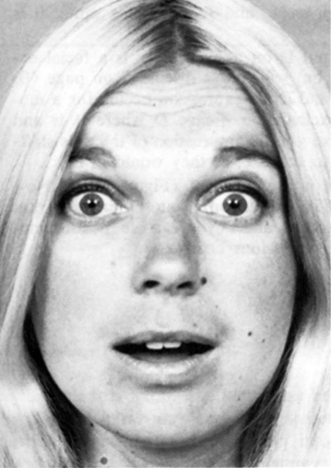
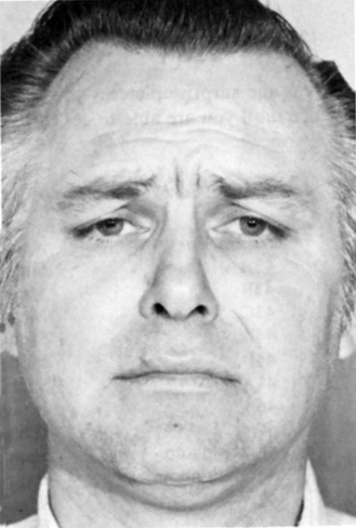
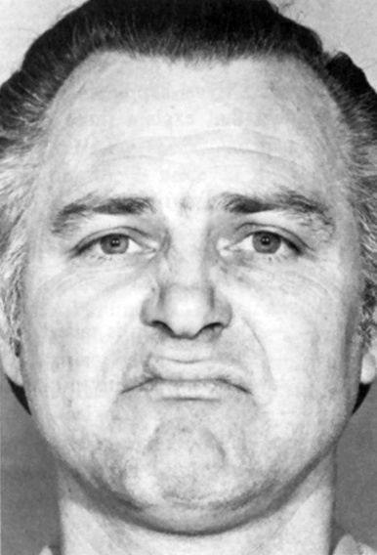
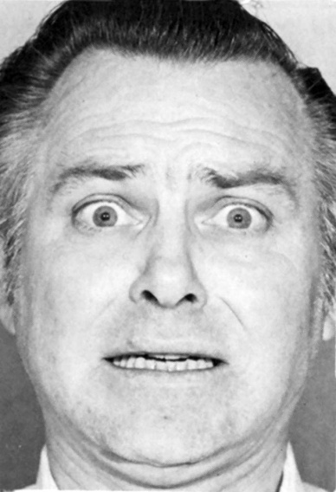
Can You Label These Emotions?
Notes:
Happiness, anger, surprise, disgust, sadness, fear

Slide 33
Emotion
Emotion:
A state of arousal involving facial and body changes, brain activation, cognitive appraisals, subjective feelings, and tendencies toward action, all shaped by cultural rules.
Subjective experiences that arise spontaneously and unconsciously in response to the environment around us.

Slide 34
Cont.
It can be defined as the “feeling” aspect of consciousness, characterized by certain physical arousal, certain behavior that reveals the feeling to the outside world, and an inner awareness of feelings.
Thus, from this short definition, we can understand that there are three elements of emotion: the physiology, behavior, and subjective experience.

Slide 35
Cont.
The physiology of emotion - when a person experiences an emotion, there is physical arousal created by the sympathetic nervous system.
The heart rate increases, breathing becomes more rapid, the pupils of the eye dilate, and the mouth may become dry.
The behavior of emotion- tells us how people behave in the grip of an emotion.
There are facial expressions, body movements, and actions that indicate to others how a person feels.
Frowns, smiles, and sad expressions combine with hand gestures, the turning of one‘s body, and spoken words to produce an understanding of emotion.

Slide 36
Cont.
Subjective experience or labeling emotion-is the third component of emotion and it involves interpreting the subjective feeling by giving it a label: anger, fear, disgust, happiness, sadness, shame, interest, surprise and so on.
Another way of labeling this component is to call it the ―cognitive component, because the labeling process is a matter of retrieving memories of previous similar experiences, perceiving the context of the emotion, and coming up with a solution- a label.

Slide 37
Emotion (Conti…)
How can we know emotion in others?
Through non-verbal cues such as facial expressions, eye-contact, body movements and posture, and touching.

Slide 38
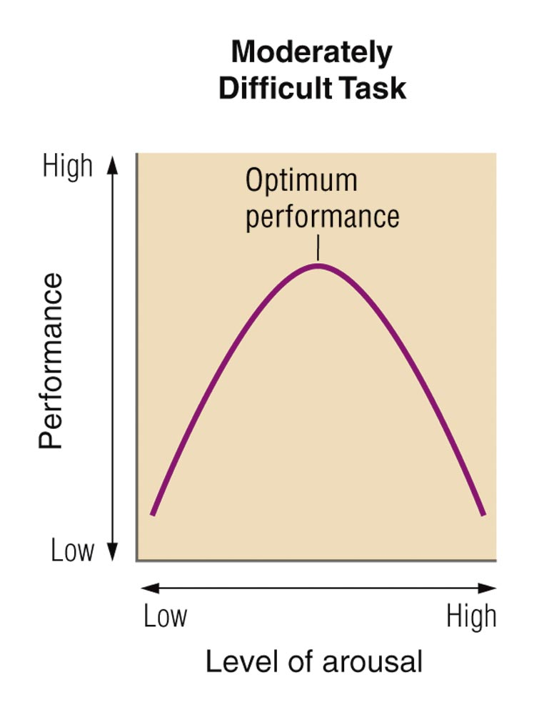
Purposes of Emotion
Arousal
Arousal – get us ready to make a needed response (motivate studying for a test) or Fight or Flight
Communication: make our needs/wants known to others, or our intentions (what might you do if you are really frustrated? Punch/hit a wall, yell at someone)
The Yerkes-Dodson La
Notes:
Arousal – get us ready to make a needed response (motivate studying for a test)
Optimum level of arousal – we don’t do well if not very aroused, but we also don’t do well if too aroused – there’s a happy medium
Communication – make our needs/wants known to others, or our intentions (what might you do if you are really frustrated? Punch a wall, yell at someone)

Slide 39
Theories of Emotion
Does your heart pound because you are afraid... or are you afraid because you feel your heart pounding?

Slide 40
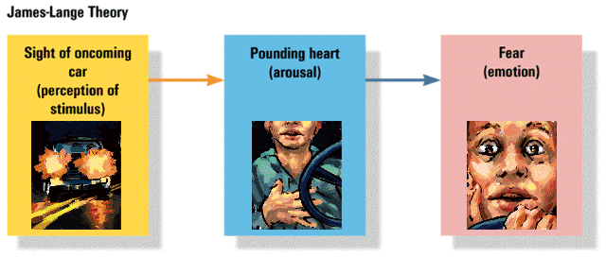
1. James-Lange Theory of Emotion
Experience of emotion is awareness of physiological responses to emotion-arousing stimuli
Emotion arises from physiological arousal
Sight of
oncoming
car
(perception of
stimulus)
Pounding
heart
(arousal)
Fear
(emotion)

Slide 41
2. Cannon-Bard Theory of Emotion
Pounding
heart
(arousal)
Emotion-arousing stimuli simultaneously trigger:
physiological responses
subjective experience of emotion
Sight of
oncoming
car
(perception of
stimulus)
Fear
(emotion)

Slide 42

3. Schachter and Singer Two-Factor and Cognitive Arousal Theory
To experience emotion one must:
be physically aroused
cognitively label the arousal
That is:
Event- arousal + reasoning-emotion
Pounding
heart
(arousal)
Sight of
oncoming
car
(perception of
stimulus)
Fear
(emotion)
Cognitive
label
“I’m afraid”

Slide 43
4. Lazarus Theory
Lazarus Theory states that a thought must come before any emotion or physiological arousal.
In other words, you must first think about your situation before you can experience an emotion.
EXAMPLE: You are walking down a dark alley late at night. You hear footsteps behind you and you think it may be a robber so you begin to tremble, your heart beats faster, and your breathing deepens and at the same time experience fear.
EVENT _____Thought _____physical arousal + emotion

Slide 44
5. Facial Feedback Theory
According to the facial feedback theory, emotion is the experience of changes in our facial muscles.
In other words, when we smile, we then experience pleasure, or happiness. When we frown, we then experience sadness.
It is the changes in our facial muscles that cue our brains and provide the basis of our emotions.
Just as there are an unlimited number of muscle configurations in our face, so too are there a seemingly unlimited number of emotions.

Slide 45
Cont..
EXAMPLE: You are walking down a dark alley late at night. You hear footsteps behind you and your eyes widen, your teeth clench and your brain interprets these facial changes as the expression of fear. Therefore you experience the emotion of fear.
Event_______ Facial Changes _______ Emotion

